Slide 1
Team 5 – Rotor Blade Structures
Week No - 9
Date - 25.11.2025
Supervisor - Dr. Laurence Alhrshy
Presented by – Bhima Babu Masare (770246)
Team Members - Bhima B Masare, Anudeep Allanki, Dongsuk Kim, Mithun Shetty

Slide 2
Contents
1. Rotor Blade Structures Team Time line
2. Tasks planned for Project
3. Spar Cap -
  3.1 About Spar Caps
      3.1.1 Types of Spar Caps
      3.1.2 Types of Bending Moments on Spar Caps
      3.1.3 Bending Stresses & Stiffness of Spar Caps
      3.1.4 Blade Design using NuMAD
      3.1.5 Developing the Blade of WEC 2025 Optimus Syria in NuMAD (Test 1)
      3.1.6 Bending Stress Analysis on Spar Caps (updated results)
Bibliography
Bhima Babu Masare

Slide 3
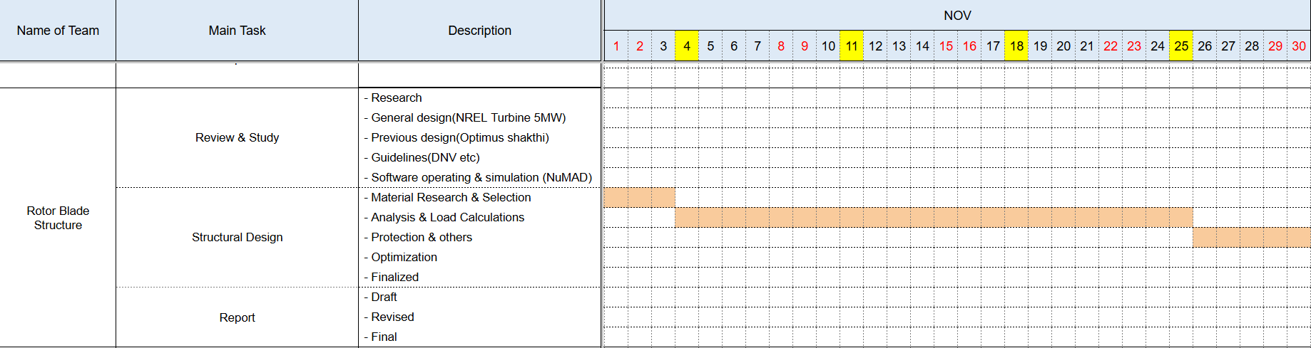
1. Rotor Blade Structures Team Time line -
1.1 Team Time line for Month November -
Bhima Babu Masare

Slide 4
2. Tasks planned for Project –
Material Selection
Spar Cap & Shear Web Thickness
Develop Blade Model in NuMAD
Analysis with Precomp
Iterate and refine the design
Bhima Babu Masare

Slide 5
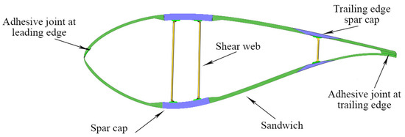
3. Spar Caps –
3.1 About Spar Caps -
The main structural component (backbone) of a wind turbine blade.
They are long, thick beams that run along the length of the blade.
Located on the top (suction side) and bottom (pressure side) of the blade's main spar, or internal box beam.
Their primary job is to give the blade its stiffness and strength.
Figure 1 – Blade Structures
Source - Impact of Process Technology on Properties of Large-Scale Wind Turbine Blade Composite Spar Cap by Yuanrong Sun, Congli Hu, Jianbo Li
Bhima Babu Masare

Slide 6
3. Spar Caps –
3.1.1 Types of Spar Caps –
a. Box Spar Design –
  It is the most common and conventional design.
  These two caps are connected by one or more vertical shear webs, forming a strong, hollow "box beam" that runs down the length of the blade.
Bhima Babu Masare

Slide 7
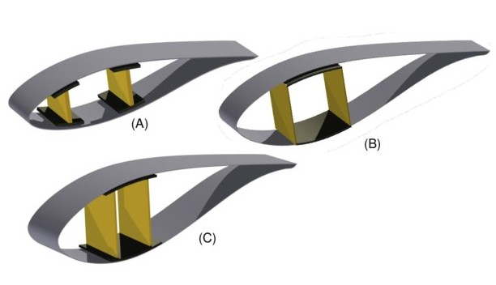
3. Spar Caps –
3.1.1 Types of Spar Caps –
a. Box Spar Design –
Figure 2 – Box Spar Caps,
A: three cell with shear webs & spar caps,
B: three cell box type, with single inter-web capping,
C: three cell, with single capping extending fore and aft of the shear webs.
Source - Multi-disciplinary constraint optimization of wind turbines by Carlo Luigi Bottasso, Filippo Campagnolo, Alessandro Croce
Bhima Babu Masare

Slide 8
3. Spar Caps –
3.1.1 Types of Spar Caps –
a. Box Spar Design –
1. Main Features related to Structural Aspects –
    Box Girder Flanges – The spar caps function as the upper & lower flanges of a closed-cell box beam.
    Double Shear Web Integration – Each cap is bonded to two vertical shear webs
    Closed-Cell Topology – The assembly forms a hollow, closed loop, providing exceptional torsional rigidity.
    Decoupled Structure – The spar caps are part of an independent internal skeleton, separating the load-bearing function from the aerodynamic skin.
Bhima Babu Masare

Slide 9
3. Spar Caps –
3.1.1 Types of Spar Caps –
a. Box Spar Design –
2. Main Features related to Mechanical Aspects –
    Flapwise Moment Resistance – Specifically designed to absorb high flapwise bending moments (forces pushing the blade back).
    Buckling Stability – The box configuration stabilizes the caps against panel buckling.
    High Moment of Inertia – The caps are spaced far apart to maximize the area moment of inertia, reducing material usage for the same stiffness.
Bhima Babu Masare

Slide 10
3. Spar Caps –
3.1.1 Types of Spar Caps –
a. Box Spar Design –
3. Main Features related to Material & Manufacturing Aspects –
    Unidirectional (UD) Reinforcement – Composed almost exclusively of 0° oriented fibers (e.g., Carbon or Glass) to maximize axial stiffness.
    Constant or Tapered Width – Often feature a controlled width to accommodate the bond lines for both shear webs.
    Adhesive Interfaces – Feature critical bond lines on both the inner surface (to shear webs) and outer surface (to the blade shell).
Bhima Babu Masare

Slide 11
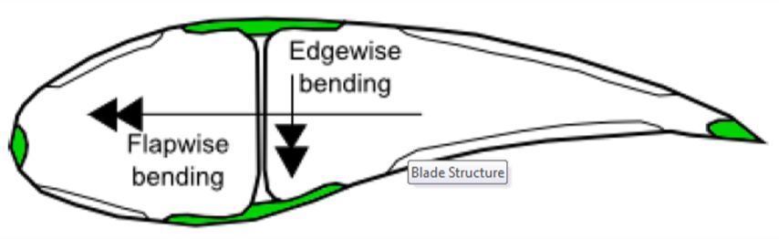
3. Spar Caps –
3.1.2 Types of Bending Moments on Spar Caps –
a. Primary Bending - Flapwise Bending
b. Secondary Bending: Edgewise Bending
Figure 3 – Bending Moments on Spar Caps
Source – Lecture Scripts from Prof. Dr. Francesco Previtali
Bhima Babu Masare

Slide 12

3. Spar Caps –
3.1.3 Bending Stresses & Stiffness of Spar Caps –
a. Bending Stiffness (also called Flexural Rigidity) -
  It is the spar cap's fundamental resistance to bending.
  It's the most important property for preventing the blade from deflecting too much and striking the tower.
  It is NOT the same as strength (which is resistance to breaking).
  Stiffness is resistance to bending.
here,
  E = Young's Modulus (Material Stiffness),
  I = Second Moment of Area (Shape Stiffness)
$$Bending Stiffness = E×I$$
Bhima Babu Masare

Slide 13
3. Spar Caps –
3.1.3 Bending Stresses & Stiffness of Spar Caps –
b. Bending Stress -
  1. Maximum Stress (σ_{max}) –
    The highest tensile (pulling) stress experienced by the spar cap during its rotation.
    This occurs on the suction side (top) spar cap when the blade is hit by a strong gust of wind, causing it to bend backward (flapwise bending).
  2. Minimum Stress (σ_{min}) –
    The highest compressive (pushing) stress experienced by the spar cap.
    This occurs on the pressure side (bottom) spar cap during that same strong gust of wind.
Bhima Babu Masare

Slide 14
3. Spar Caps –
3.1.4 Blade Design using NuMAD –
a. NuMAD (Numerical Manufacturing And Design)
  What is it: An open-source, MATLAB-based software tool developed by Sandia National Laboratories.
  Purpose: A specialized pre-processor for 3D modeling and structural design of wind turbine blades.
  Core Function: Bridges the gap between aerodynamic design (airfoils/chord/twist) and structural analysis (FEA).
  Key Output: Generates high-fidelity finite element models (ANSYS) and input files for aeroelastic codes (OpenFAST).
Bhima Babu Masare

Slide 15
3. Spar Caps –
3.1.4 Blade Design using NuMAD –
a. NuMAD (Numerical Manufacturing And Design) –
Step 1 – Geometry Definition
Step 2 – Material & Composite Definition
Step 3 – Internal Structural Layout
Step 4 – Mesh Generation & FEA Export
Bhima Babu Masare

Slide 16
3. Spar Caps –
3.1.4 Blade Design using NuMAD –
a. NuMAD (Numerical Manufacturing And Design) –
Step 1 – Geometry Definition –
    Airfoil Import: Import standardized airfoil coordinates (e.g., NACA, DU series) for different spanwise stations.
    Planform Inputs: Define spanwise distributions for Chord, Twist, and Relative Thickness.
    Axis Alignment: Set the Pitch Axis and Pre-bend/Sweep curves to define the blade's 3D path.
    Lofting: NuMAD automatically creates the outer skin surface (OML - Outer Mold Line) by interpolating between defined stations.
Bhima Babu Masare

Slide 17
3. Spar Caps –
3.1.4 Blade Design using NuMAD –
a. NuMAD (Numerical Manufacturing And Design) –
Step 2 – Material & Composite Definition –
    Isotropic & Orthotropic: Define base materials (e.g., fiberglass, carbon fiber, balsa wood, foam, epoxy).
    Composite Stacks: Create "blocks" or "stacks" of materials representing the layup (e.g., [0, +45, -45, 90] degree plies).
    Material Database: NuMAD manages a library of material properties (E1, E2, Density, Nu12) ensuring consistency across the design.
    Layer Thickness: precise control over individual ply thickness and total laminate depth.
Bhima Babu Masare

Slide 18
3. Spar Caps –
3.1.4 Blade Design using NuMAD –
a. NuMAD (Numerical Manufacturing And Design) –
Step 3 – Internal Structural Layout –
    Component Placement: Define regions for Spar Caps, Leading Edge (LE) panels, & Trailing Edge (TE) reinforcement.
    Shear Webs: Insert and position shear webs (vertical stiffeners) relative to the chord line.
    Material Assignment: Assign specific composite stacks to different regions (e.g., Unidirectional Carbon for Spar Caps, Biaxial Glass for Shear Webs).
    Transitions: Manage material drop-offs and transitions along the span (tapering thickness).
Bhima Babu Masare

Slide 19
3. Spar Caps –
3.1.4 Blade Design using NuMAD –
a. NuMAD (Numerical Manufacturing And Design) –
Step 4 – Mesh Generation & FEA Export –
    Shell Meshing: NuMAD discretizes the geometry into shell elements suitable for FEA.
    ANSYS Integration: Automatically generates APDL (ANSYS Parametric Design Language) scripts to build the full model in ANSYS.
    Sectional Properties: Computes beam properties (Stiffness EI, Mass per length) for use in OpenFAST/BModes.
    Fidelity Control: User controls mesh density and element type for computational efficiency.
Bhima Babu Masare

Slide 20
3. Spar Caps –
3.1.5 Developing the Blade of WEC 2025 Optimus Syria in NuMAD –
a. Airfoils –
    Node 01 – Circular Airfoil (D = 3.45 m)
    Node 02 – Circular Airfoil (D = 3.0 m)
    Node 03 – D60_V5
    Node 04 – DU408B
    Node 05 – DU35_A17
    Node 06 – DU30_A17
    Node 07 – DU25_A17
    Node 08 – DU21_A17
    Node 09 – NACA 63(3)-618
    Node 10 – NACA 63(3)-618
Bhima Babu Masare

Slide 21
3. Spar Caps –
3.1.5 Developing the Blade of WEC 2025 Optimus Syria in NuMAD –
b. Blade Geometry Details –
Nodes | Pos [m] | Chord [m] | Twist [deg] | Airfoil
01 | 0 | 3.45 | 18 | Circular_Foil
02 | 4.258 | 3 | 17 | Circular_Foil
03 | 8.308 | 4.6 | 16 | D60B_V5
04 | 12.357 | 4.8 | 15.09 | DU40B
05 | 32.505 | 4.5 | 12.575 | DU35_A17
06 | 36.61 | 3.77 | 9.621 | DU30_A17
07 | 50.39 | 3.268 | 6.516 | DU25_A17
08 | 63.495 | 2.791 | 3.562 | DU21_A17
09 | 74.643 | 2.386 | 1.05 | NACA 63_(3)-618
10 | 77.75 | 2 | 0 | NACA 63_(3)-618
Bhima Babu Masare

Slide 22
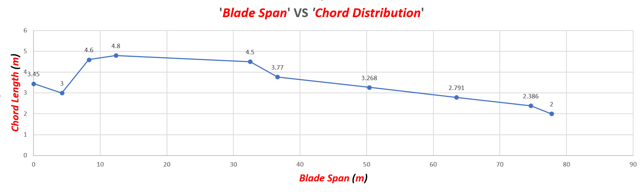
3. Spar Caps –
3.1.5 Developing the Blade of WEC 2025 Optimus Syria in NuMAD –
c. ‘Blade Span’ VS ‘Chord Distribution’ –
Bhima Babu Masare

Slide 23
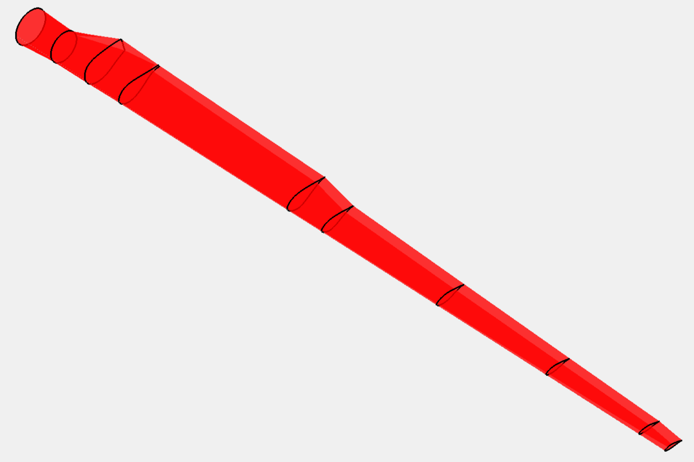
3. Spar Caps –
3.1.5 Developing the Blade of WEC 2025 Optimus Syria in NuMAD –
d. Blade Model in NuMAD – (Test 1)
Figure 4 – Blade Model in NuMAD
Bhima Babu Masare

Slide 24
3. Spar Caps – (Update from Last Week)
3.1.6 Bending Stress Analysis on Spar Caps –
  a. Input Tables – (from WEC Shakthi 2024)
    loads.csv: spanwise position & flapwise bending moments
    thickness.csv: blade thickness (distance between spar caps)
  b. Material Properties –
    Glass Fiber: E = 43 GPa, σ_max = 750 MPa, ρ = 1930 kg/m³, SF = 1.6
Bhima Babu Masare

Slide 25
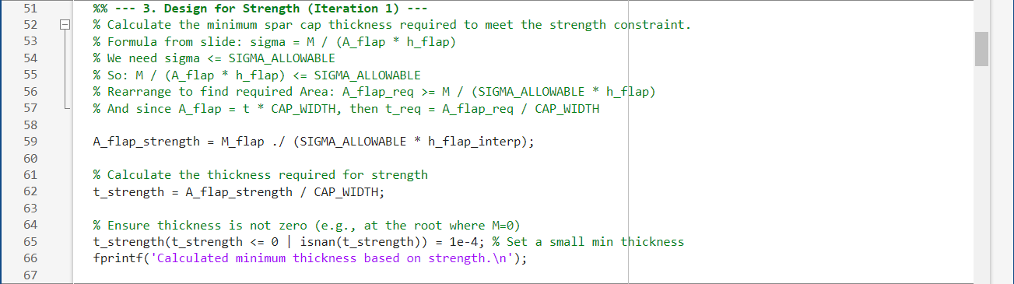
3. Spar Caps – (Update from Last Week)
3.1.6 Bending Stress Analysis on Spar Caps – (updated code)
  c. MatLab Code for Maximum Stress (σmax) & Minimum Stress (σmin)
  d. MatLab Code for Bending Stiffness (EI) for Flapwise & Edgewise Bending
Bhima Babu Masare

Slide 26
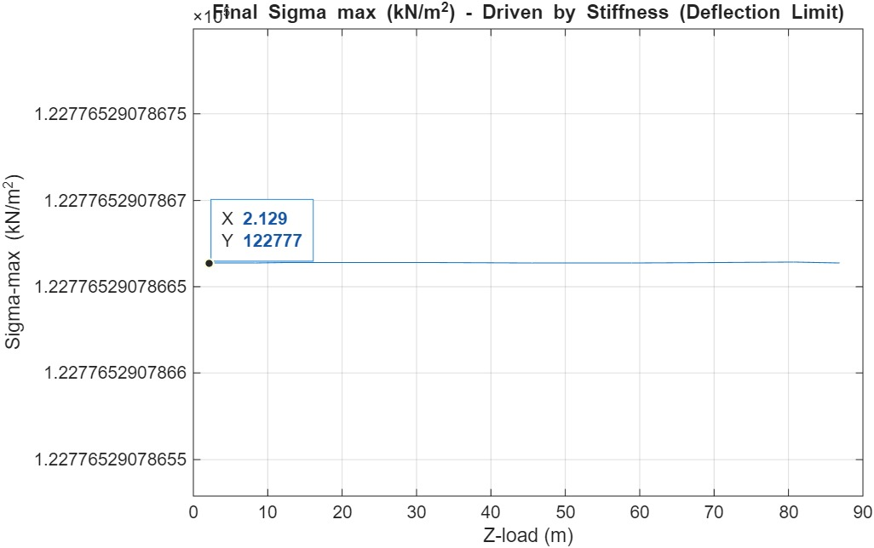
3. Spar Caps – (Update from Last Week)
3.1.6 Bending Stress Analysis on Spar Caps –
  e. Plots from MatLab for Maximum Stress (σmax) (updated from Week 7)
Bhima Babu Masare

Slide 27
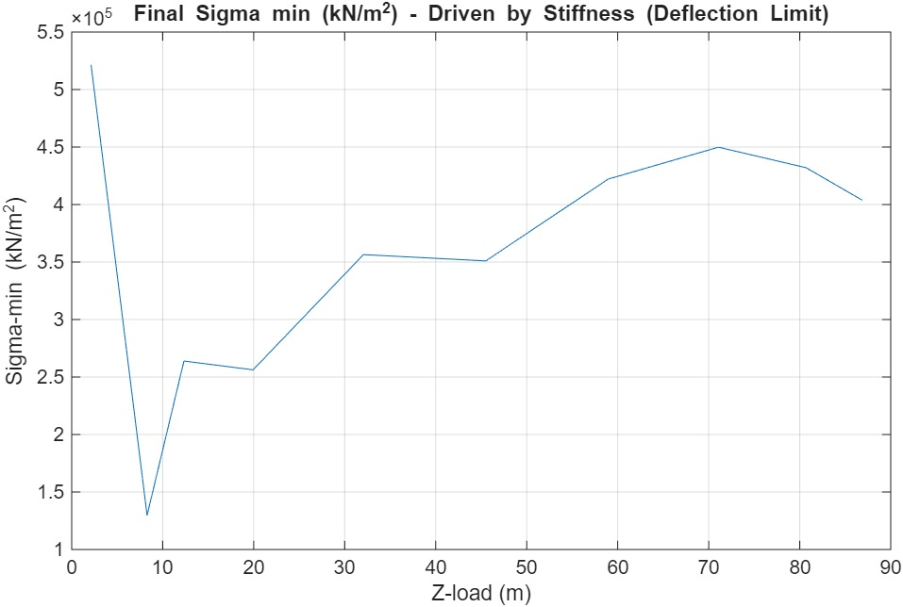
3. Spar Caps – (Update from Last Week)
3.1.6 Bending Stress Analysis on Spar Caps –
  f. Plots from MatLab for Minimum Stress (σmin) (updated from Week 7)
Bhima Babu Masare

Slide 28
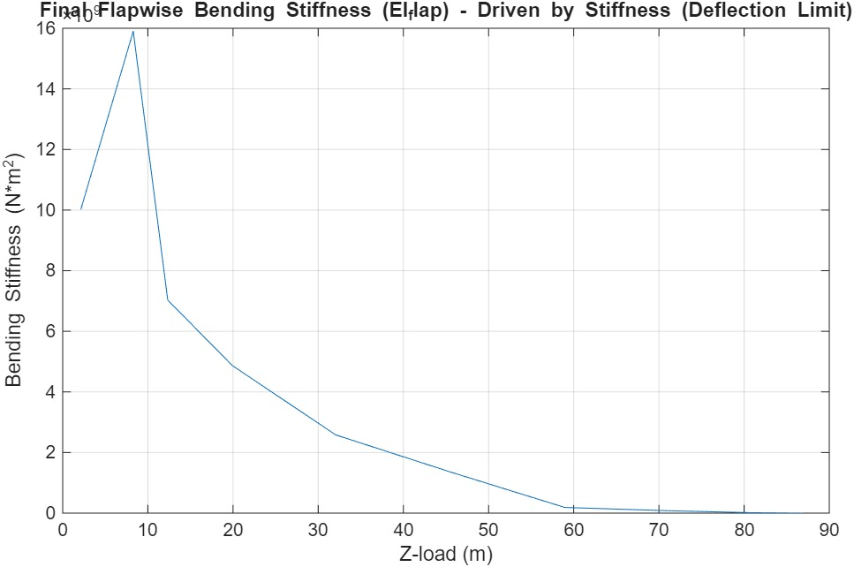
3. Spar Caps – (Update from Last Week)
3.1.6 Bending Stress Analysis on Spar Caps –
  g. Plots from MatLab for Bending Stiffness (EI) for Flapwise Bending (updated from Week 7)
Bhima Babu Masare

Slide 29
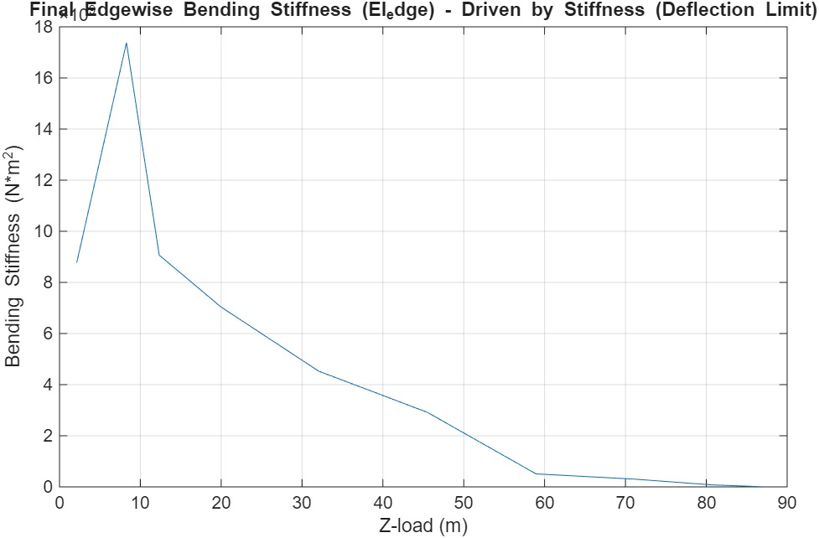
3. Spar Caps – (Update from Last Week)
3.1.6 Bending Stress Analysis on Spar Caps –
  h. Plots from MatLab for Bending Stiffness (EI) for Edgewise Bending (updated from Week 7)
Bhima Babu Masare

Slide 30
Bibliography
Definition of a 5 MW/61.5m Wind Turbine Blade Reference Model by Brian R. Resor, Sandia National Laboratories, California, USA
Definition of a 5 MW Reference Wind Turbine for Offshore System Development, J. Jonkman, S. Butterfield, W. Musial, and G. Scott, National Renewable Energy Laboratory, USA
Reports from Optimus Shakthi 2024
Lecture Scripts from Prof. Dr. Francesco Previtali
Lecture Scripts from Prof. Dr. Laurence Alhrshy
Impact of Process Technology on Properties of Large-Scale Wind Turbine Blade Composite Spar Cap by Yuanrong Sun, Congli Hu, Jianbo Li
Multi-disciplinary constraint optimization of wind turbines by Carlo Luigi Bottasso, Filippo Campagnolo, Alessandro Croce
A concept study of a carbon spar cap design for a 80m wind turbine blade by Malo Rosemeier, M Bätge
Design & Analysis of Equipment for Load Introduction during Full Scale Blade Test by J. Andersen, M. Escudero, L. Larsen, J. Thuesen, A. Vissamsetty
Bhima Babu Masare

